Slide 1
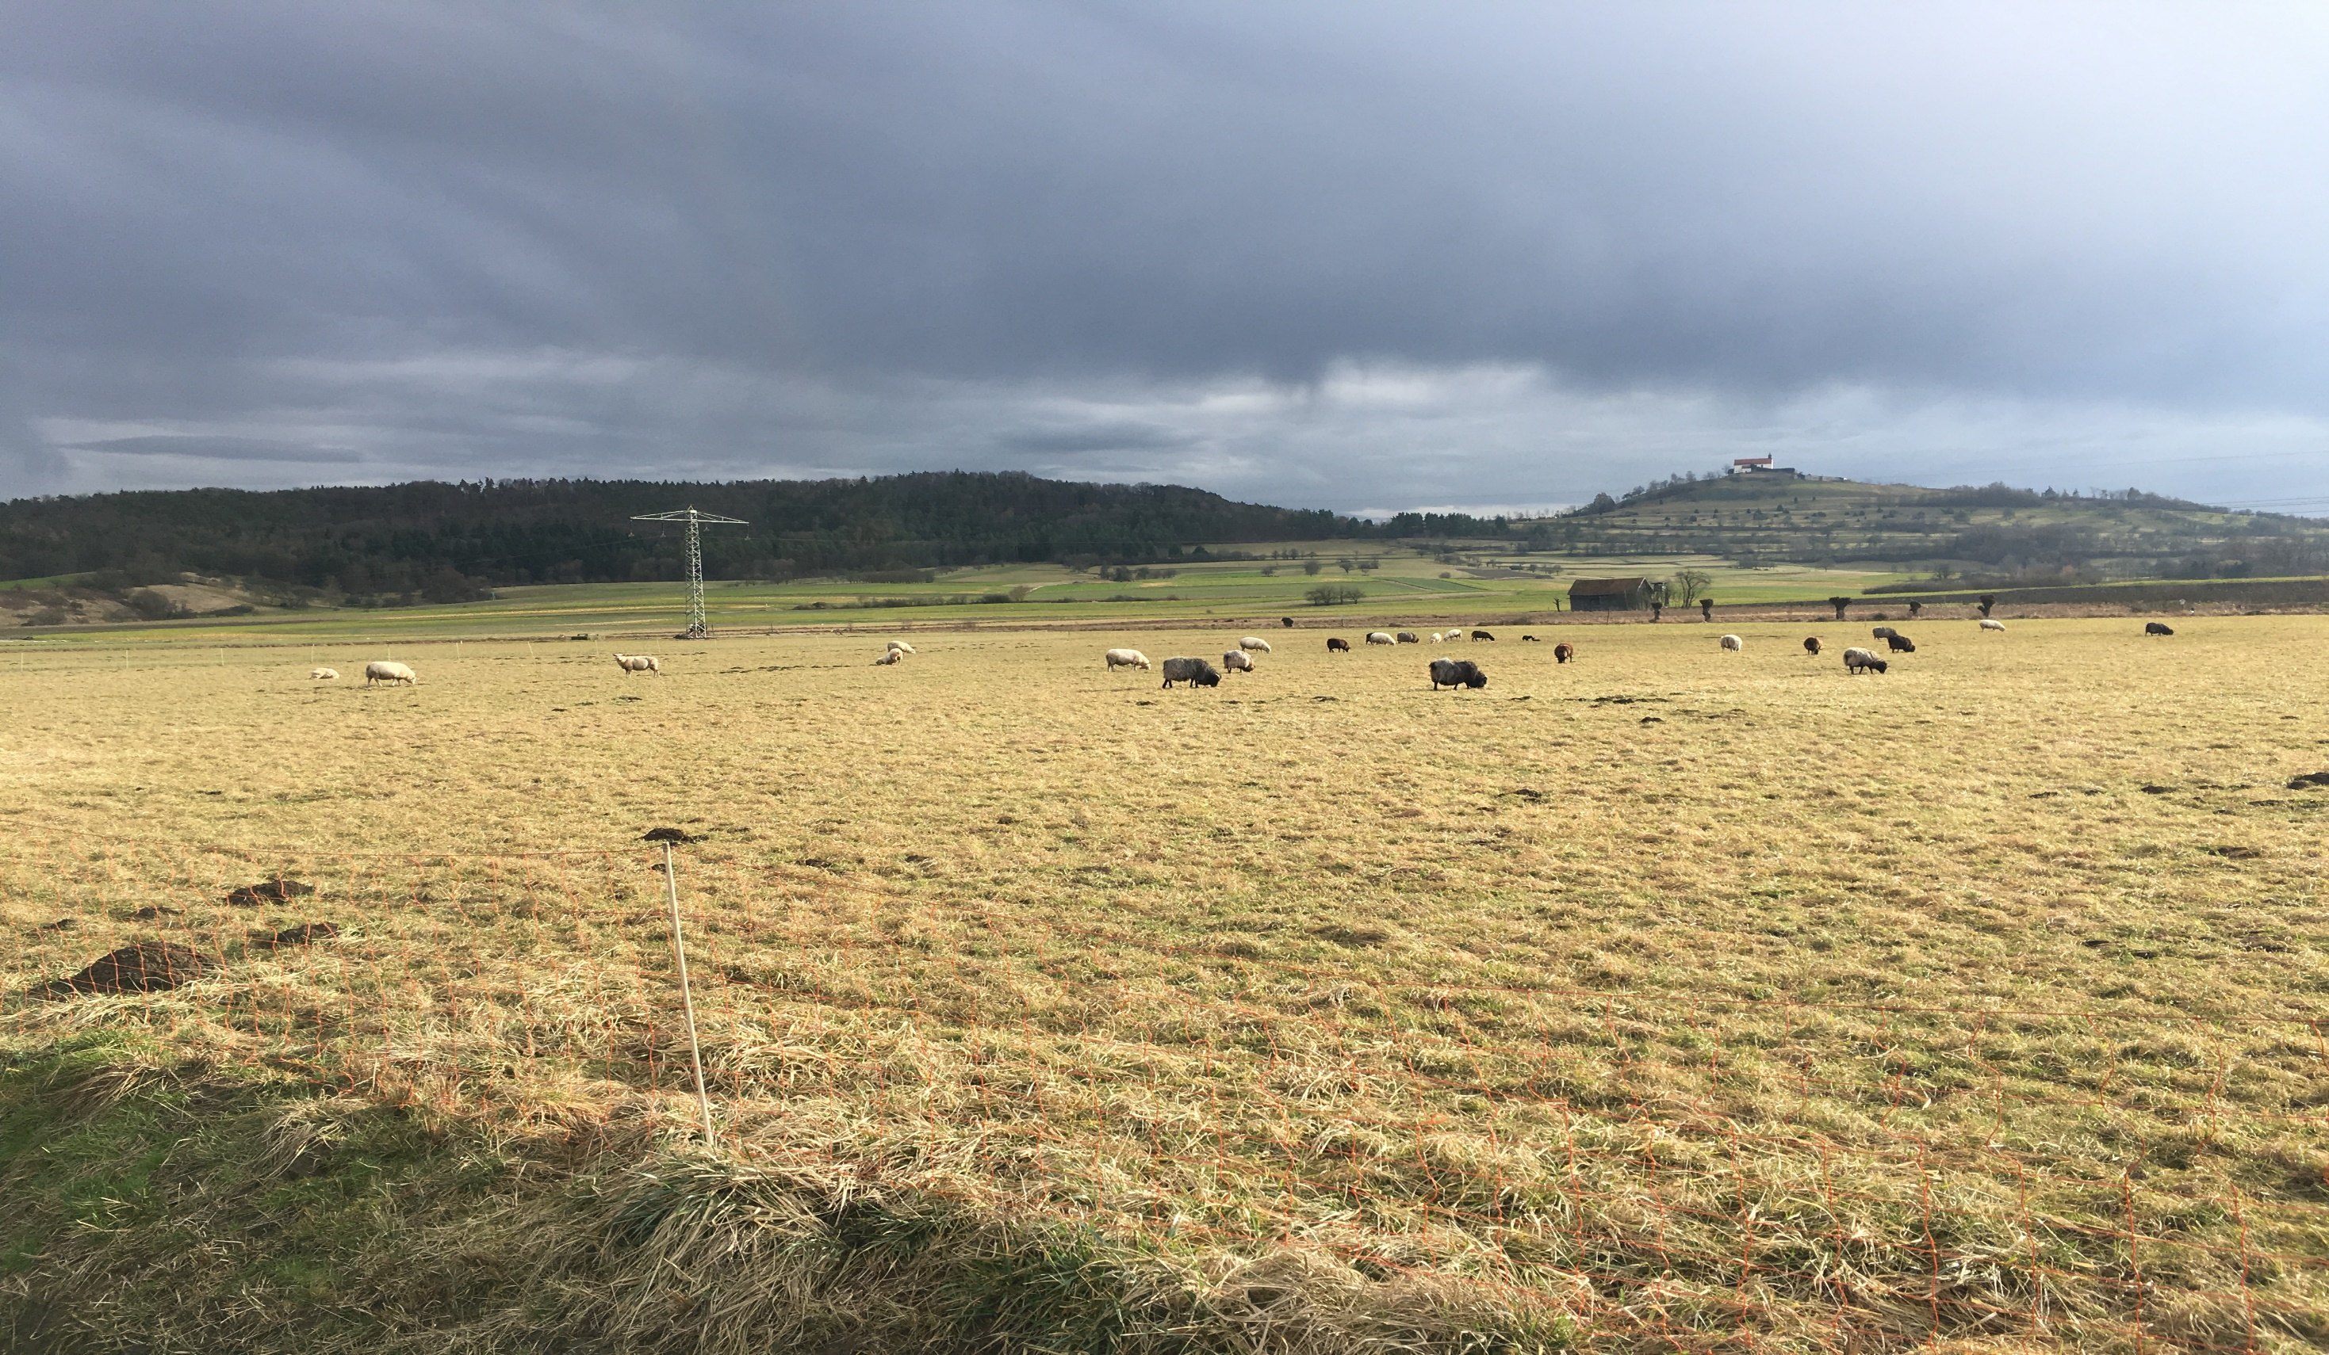
The solution to pollution is resolution: linking streambed microbial community assembly to functional potential
Zhe Wang
Ecological Microbiology (EMIC), Bayreuth Center of Ecology and Environmental Research, University of Bayreuth
May 17, 2022

Slide 2
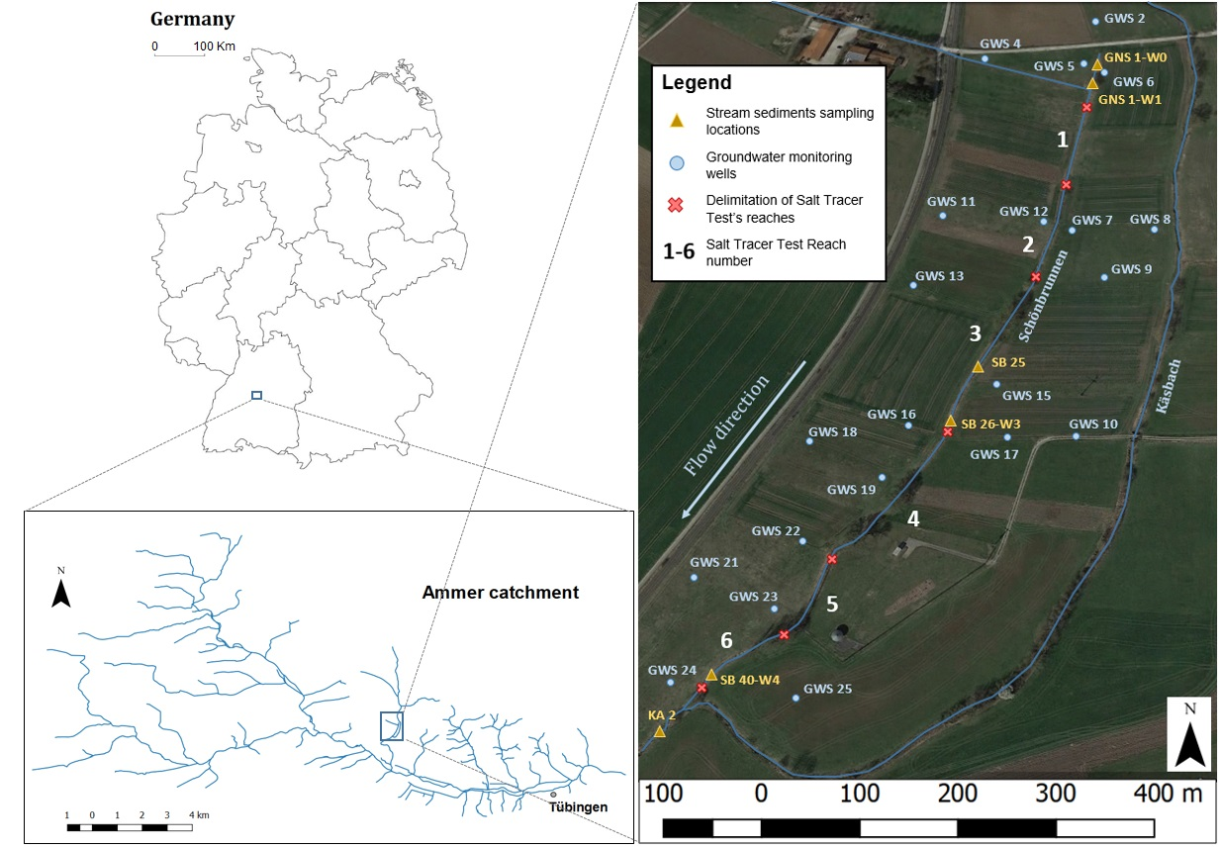
Introduction-the Schönbrunnen case
Schönbrunnen is a first-order agricultural impacted stream.
Nitrate concentration in the stream water and groundwater can reach 50-100 mg/L.
Water chemistry and isotope data supporting microbial-mediated nitrate removal occur at the top surface (0-20 cm) (transition zone) of streambed.
The studied stream length was approximately 500 m. It was divided into six reaches to find out stream and groundwater interaction.
The second-order stream Käsbach on the east side has thick gypsum units as streambed. Sulfate (SO₄²⁻) accumulation was observed.
A reach is a section of a stream or river along which similar hydrologic conditions exist

Slide 3
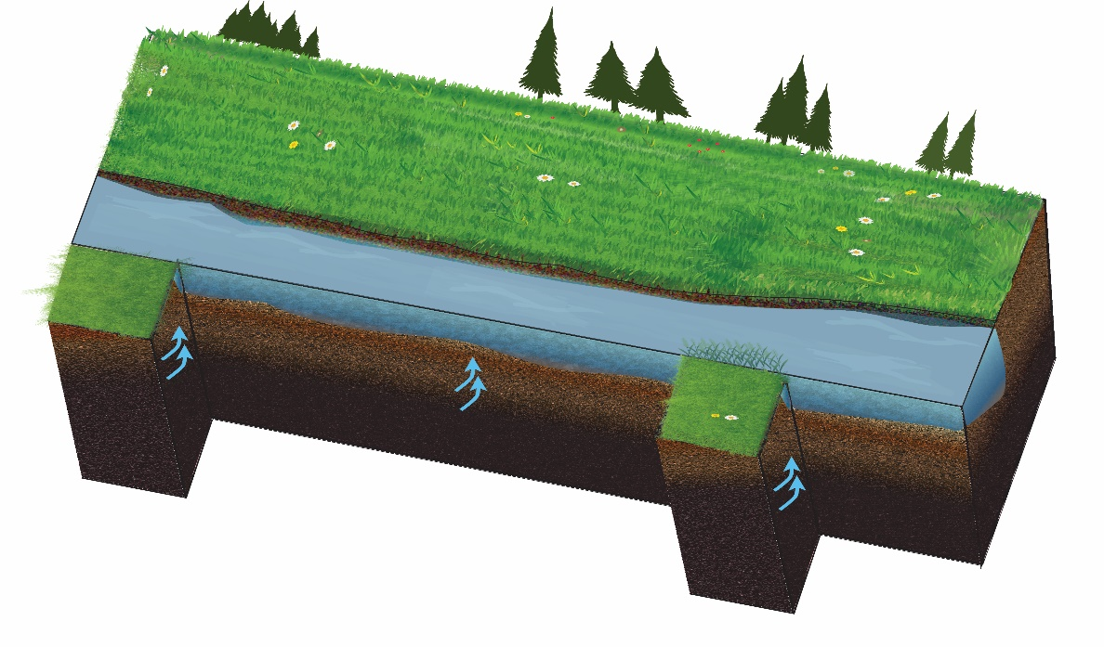
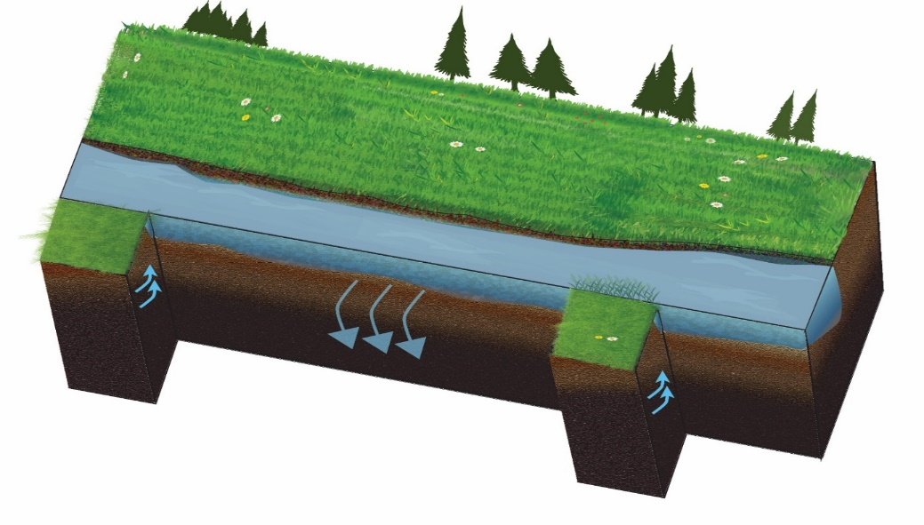
Introduction-bidirectional water exchange
Agricultural headwater: a normal drainage pipe
Bidirectional stream-groundwater exchange:
Agricultural headwater: a normal drainage pipe?
Controls of reactivity? Impacts on microbial communities?
Oxygen + nitrate??
Reduces sulfur + nitrate??

Slide 4
Objectives- the structure of the talk
1. Investigate the impact of bidirectional water exchange on streambed microbial communities, and identify potential indicator taxa for ecosystem quality of the studied stream.
2. Determine the core microbial communities of the studied stream after a 3-year sampling campaign.
3. Link the core microbial communities to potential functions.
Notes:
From here, i am gonna introduce technical part and study results.

Slide 5
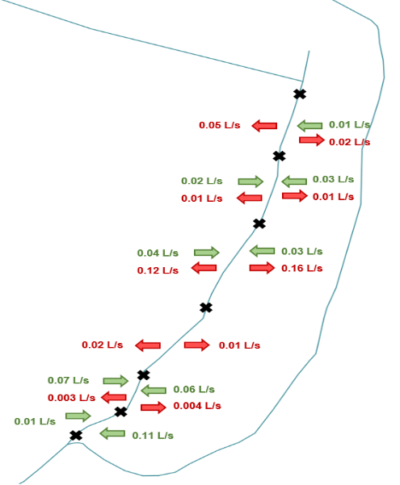
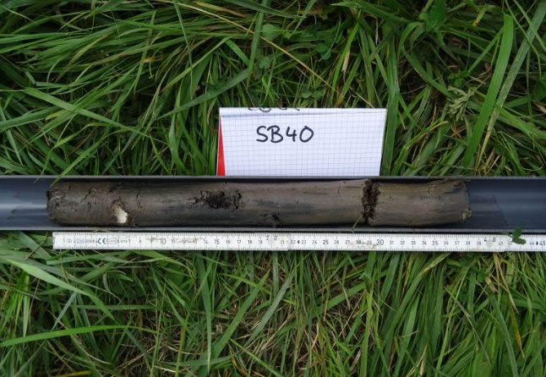
Impact of bidirectional water exchange
Loss
Upstream
Up-A
Gain
Up-B
Reach boundary
5cm
Mid-A
15cm
Midstream
Mid-B
Downstream
Down
Confluence
©Oscar et. al
Conf
Sampling location
Strong correlation observed between nitrate concentration and sulfate concentration
Link nitrogen cycle to sulfur cycle?

Slide 6
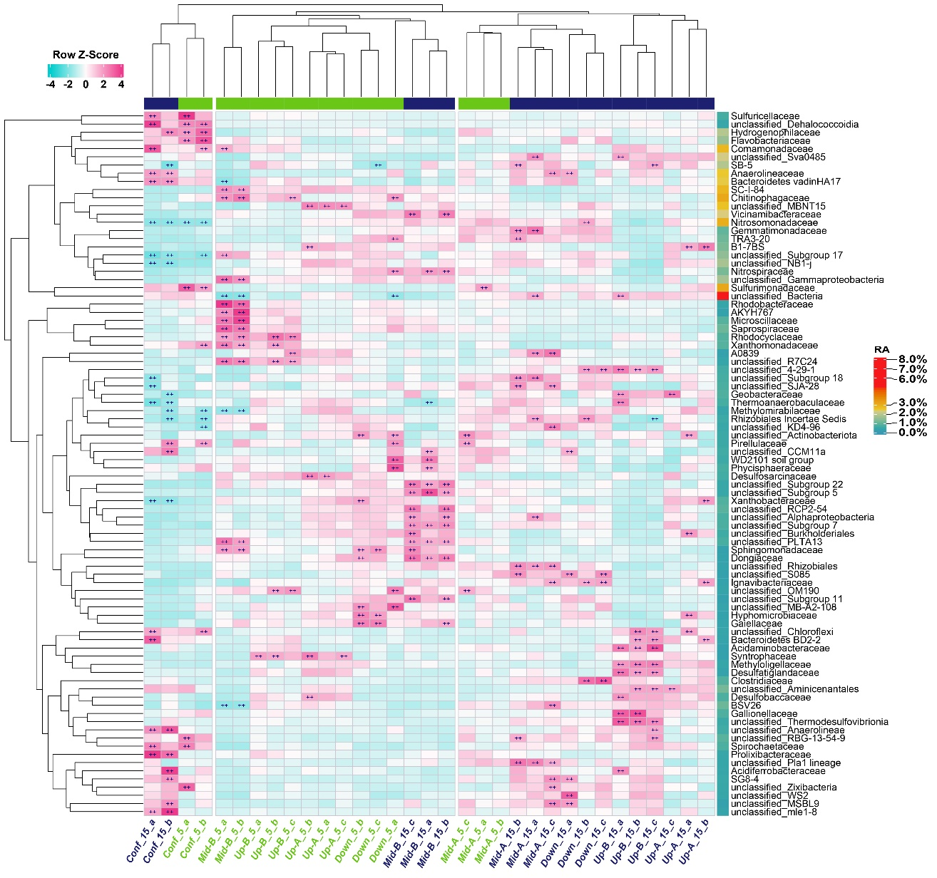
Impact of bidirectional water exchange
Dissecting streambed bacterial communities
Diverse bacterial community from streambed sediments.
Potential functional groups are among the most abundant communities
e.g. Comamonadaceae, Nitrosomonadaceae, Sulfurimonadaceae, Anaerolineaceae, Rhodocyclaceae
The Bray–Curtis dissimilarity is a statistic index used to quantify the compositional dissimilarity between two different sites, based on counts at each site.

Slide 7
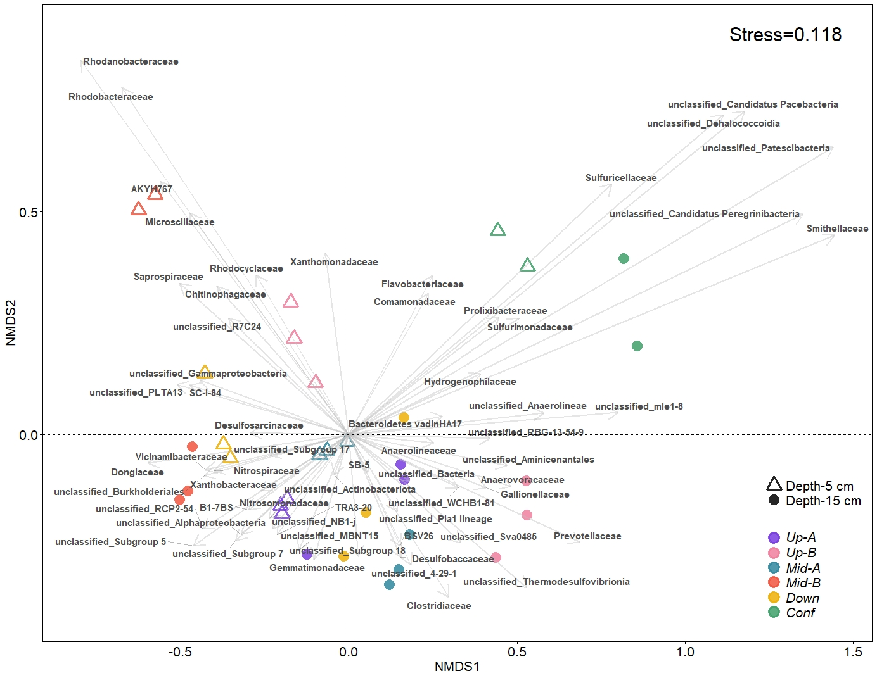
Impact of bidirectional water exchange
Most distinct taxa in separating samples
5 cm samples: heterotrophic, aerobic or facultative anaerobic microbial lineages, such as Rhodocyclaceae and Xanthomonadaceae.
15 cm samples: typical anaerobic or microaerophilic lineages, such as Anaerolineaceae and Desulfobaccaceae.
Mixed: featured typical N-cycling populations like Nitrosomonadaceae, Nitrospiraceae, and unclassified taxa like B1-7Bs.
Confluence samples: potential inorganic sulfide- and sulfur-oxidation taxa, such as Sulfuricellaceae and Sulfurimonadaceae.
Notes:
5 cm samples featured typical
In contrast, the dissimilarity of bacterial communities observed in other 15 cm samples was mainly driven by typical anaerobic or microaerophilic lineages. This included typical fermenters (Anaerolineaceae, Anaerovoracaceae, Clostridiaceae, and Prevotellaceae), potential sulfate reducers (Desulfobaccaceae, Thermodesulfovibrionia), The confluence samples were clearly distinguished from the other Schönbrunnen samples. Lineages typical for inorganic sulfide- and sulfur-oxidation (Sulfuricellaceae, Sulfurimonadaceae )
5 cm samples from Up-A, Mid-A and Down also featured populations similarly abundant at 15 cm depth of Mid-B. These included the Nitrosomonadaceae (~3%) and Nitrospiraceae (~1%)
These oxidizers may also have the nitrate reducing capacity.

Slide 8
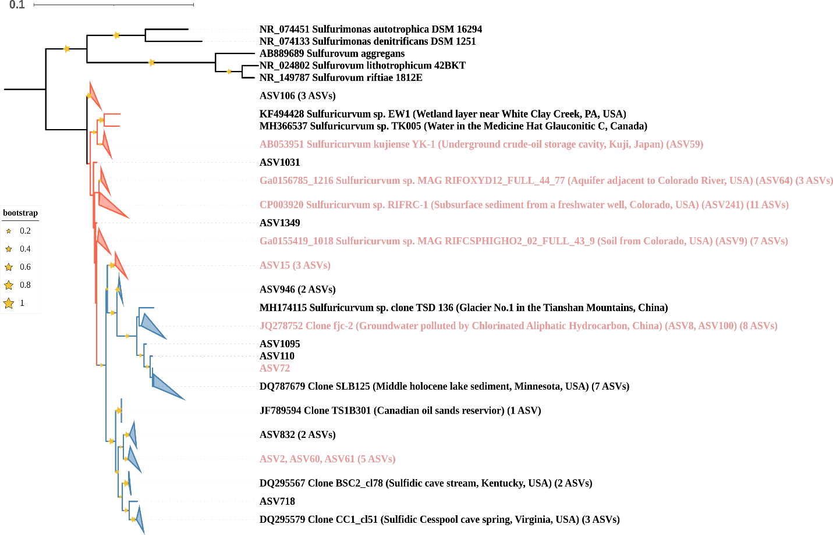
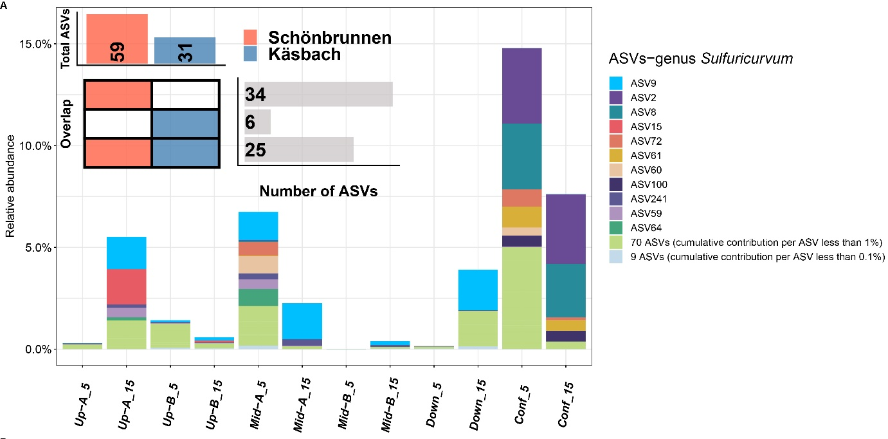
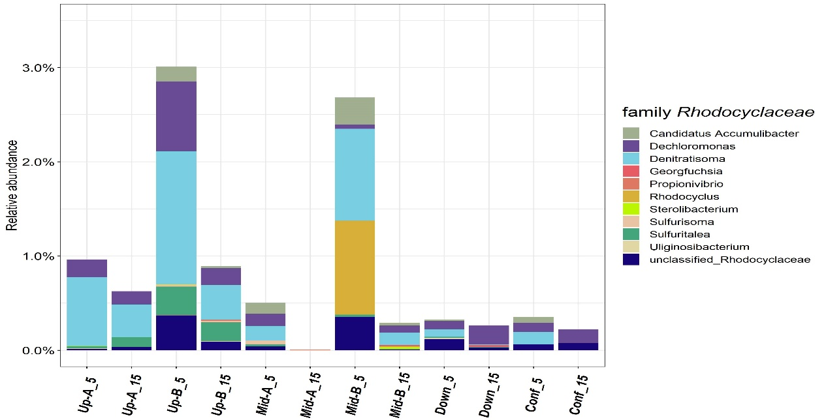
Impact of bidirectional water exchange
Sulfurimonadaceae
2 ASVs increased significantly after nitrate amended microcosm incubation.
Full length 16S rRNA sequences allow strain level resolution of potential nitrate reducers (heterotrophic and autotrophic).
Taxa as indicators of local reactivity?
A phylogenetic tree, also known as a phylogeny, is an approach that depicts the evolutionary descent of different species, organisms, or genes from a common ancestor.

Slide 9

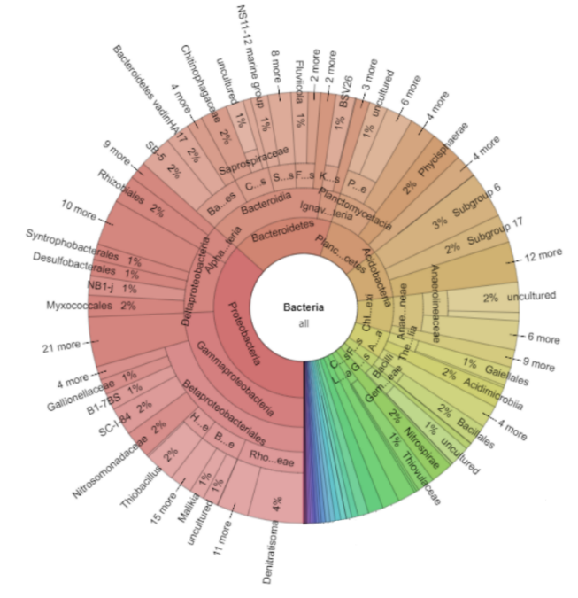
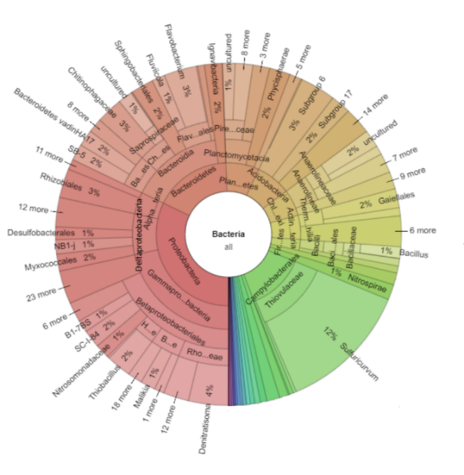
Impact of bidirectional water exchange
Sulfuricurvum sp. are potential indicators for sulfur-driven nitrate reduction.
E
Day 0
2 ASVs increased significantly
Sulfide-driven denitrification as important mechanism in denitrification at deeper gaining reaches sediments?
➔ 12% Sulfuricurvum !
Day 14

Slide 10
Impact of bidirectional water exchange

Slide 11
Core microbial communities
Microbial communities in water
How similar are microbial communities from the stream and groundwater?
Upstream: community composition in stream and groundwater samples are similar.
Upstream: community composition similarity driven by exfiltration and DO.
Downstream: community composition in stream and groundwater samples are less similar. The dissimilarity can’t be explained general chemistry data.
Streambed sediments provide buffering effect.
Notes:
Filter
Microorganisms have a high passive dispersal capacity because of their small body sizes and high abundances

Slide 12
Core microbial communities
Core microbial communities in three environments
TOP 40 abundant core families in streambed sediments
In total, these 200 core families take up 50% of total abundance.
Top 40 core families take up 31% sediment microbial communities.
Indication of impacts from water change.

Slide 13
Core microbial communities
Core microbial communities in three years

Slide 14
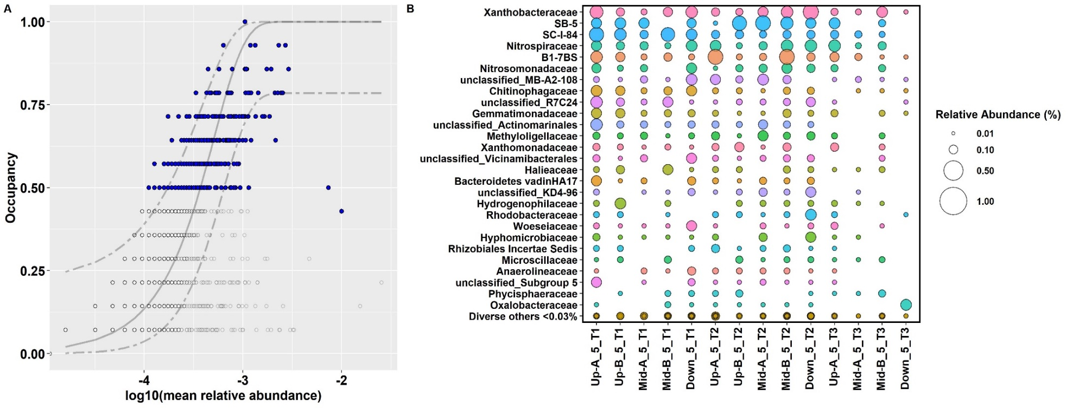
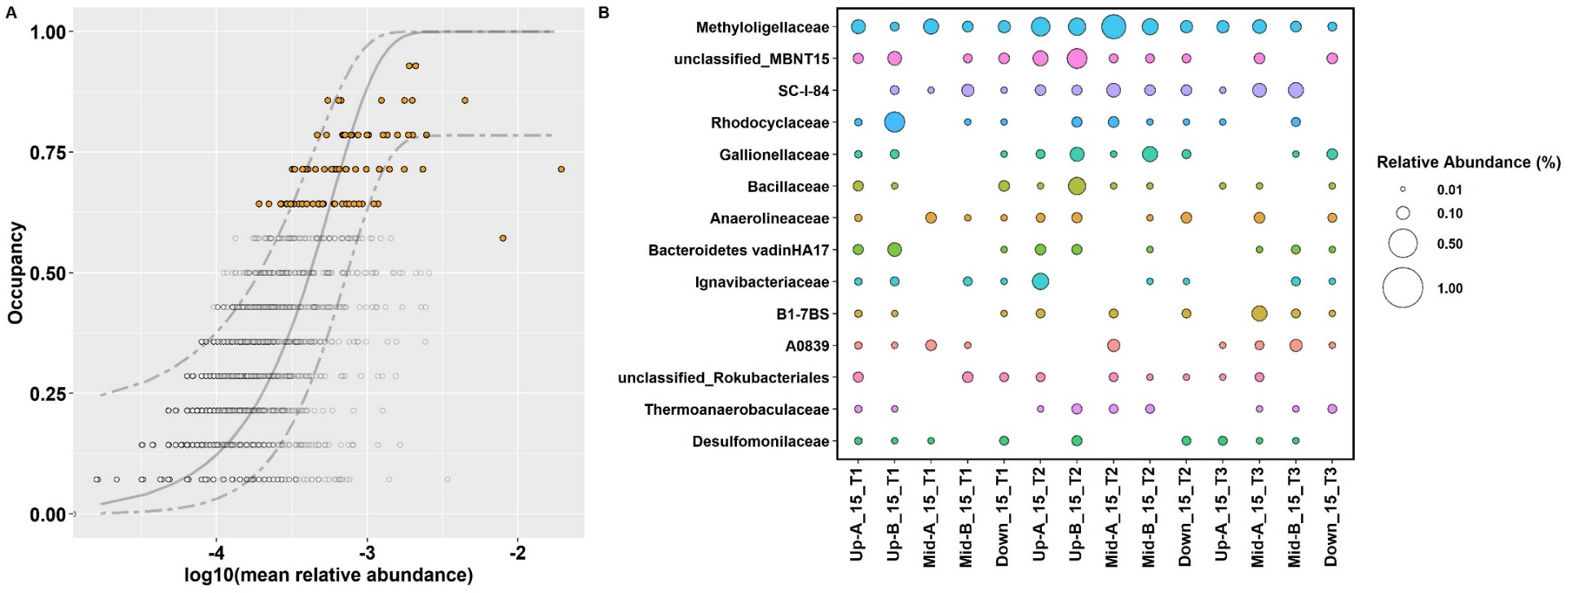
Core microbial communities
Family B1-7BS
Cumulative relatvie abundance high to low
Core microbial communities with more a stringent null model
Investigating core microbiome of Schönbrunnen steambed sediments after 3-year sampling campaign
Abundance-occupancy distributions revealed core ASVs in different depths.
More core taxa observed at 5cm depth.
ASV within family B1-7BS was detected in all 5cm samples.

Slide 15
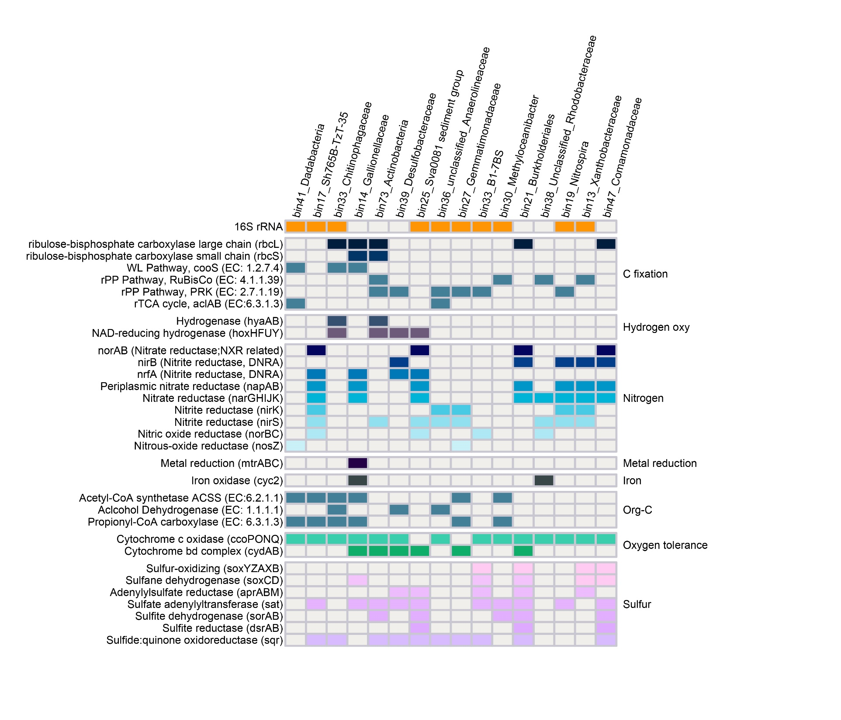
Core functions
Functions of core microbiome
16 metagenome-assembled genomes (MAGs) were recovered >60% completeness, < 10% contamination.
Members within B1-7BS are potential sulfur-oxidizers.
Majority of them have capacity for both nitrogen and sulfur metabolism.
Majority of them have capacity to thrive under low oxygen environments.
N₂O producers?
NO₃⁻
S₂O₃²⁻
narKGHJI
napAB
soxYZAXB
NO₂⁻
HS⁻
NH₄⁺
nirK
nirS
sqr
nrfA
NO
S⁰
norBC
dsrAB-dsrN
N₂O
aprABM
SO₃²⁻
nosZ
N₂
sat
SO₄²⁻
MAG completeness (%)
67.3
94.1
15

Slide 16
Core functions
Denitrification and assimilatory nitrate reduction to ammonia (ANRA) were more abundant in 5 cm samples.
Anaerobic pathways showed higher abundance in 15 cm samples.
Notes:
MaAsLin2 linear model fitting
Number of complete copies of the pathway in this sample
In conjunction with microbial community members present at differential relative abundance, we assessed the metabolic potentials of the aquarium microbial community using HUMANN3 and MaAsLin2 linear model fitting, focusing on MetaCyc Pathway definitions (Fig.

Slide 17
Core functions
narG:
Selected N-cycling gene families and contribution taxa

Slide 18
Core functions
narS:
Selected N-cycling gene families and contribution taxa

Slide 19
Core functions
nirK:
Selected N-cycling gene families and contribution taxa

